Slide 1
Flowering and its Regulation
Prepared by
Ashish Sharma, Ph.D.

Slide 2
How do plants keep track of the seasons of the year and the time of day?
Which environmental signals control flowering, and how are those signals perceived?
How are environmental signals transduced to bring about the developmental changes associated with flowering?

Slide 3
Flowers represent a complex array of functionally specialized structures that differ substantially from the vegetative plant body in form and cell types.
The transition to flowering therefore entails radical changes in cell fate within the shoot apical meristem.
The events occurring in the shoot apex that specifically commit the apical meristem to produce flowers are collectively referred to as floral evocation.

Slide 4
FLORAL MERISTEM AND FLORAL ORGAN DEVELOPMENT
Transition from vegetative to reproductive phase – increase in the frequency of cell division.
In Arabidopsis apical meristem produces phytomeres with very short internodes, resulting in a basal rosette of leaves during vegetative phase.
Reproductive development - indeterminate primary inflorescence meristem – secondary inflorescence meristem.

Slide 5
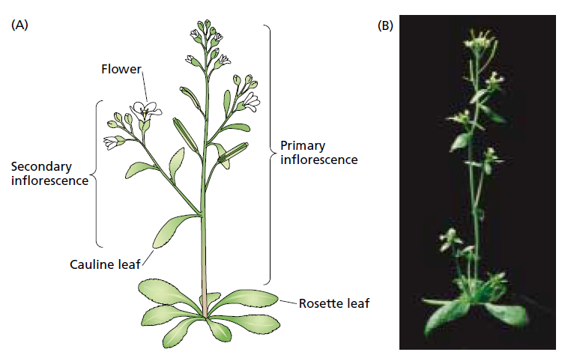

Slide 6
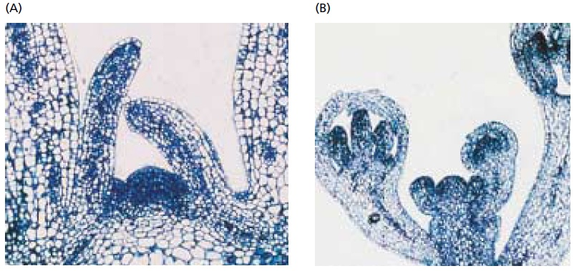

Slide 7
Floral meristems initiate four different types of floral organs:
    Sepals,
    Petals,
    Stamens, and
    Carpels

Slide 8
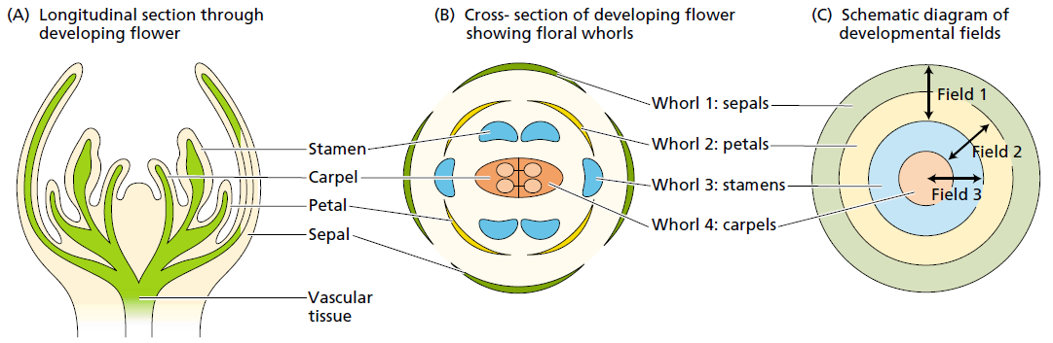

Slide 9
Three Types of Genes Regulate Floral Development
Floral organ identity genes directly control floral identity.
Cadastral genes act as spatial regulators of the floral organ identity genes by setting boundaries for their expression.
Meristem identity genes are necessary for the initial induction of the organ identity genes.

Slide 10
Meristem identity genes
Necessary for floral organ initiation.
Mutation leads to development of clusters of leaves.
Different genes include: FLORICAULA (FLO), AGAMOUS-LIKE 20 (AGL20), APETALA1 (AP1), and LEAFY (LFY).
FLORICAULA (FLO) gene controls the determination step in which floral meristem identity is established.

Slide 11
LFY performs similar function in Arabidopsis as FLO in Snapdragon.
AGL20 serve as a master switch initiating floral development.
AGL20
LFY
AP1

Slide 12
FLORAL ORGAN IDENTITY GENES
Arabidopsis: APETALA1 (AP1), APETALA2 (AP2), APETALA3 (AP3), PISTILLATA (PI), and AGAMOUS (AG).
Because mutations in these genes change floral organ identity without affecting the initiation of flowers, they are HOMEOTIC genes.
These homeotic genes fall into three classes—types A, B, and C — defining three different kinds of activities.

Slide 13
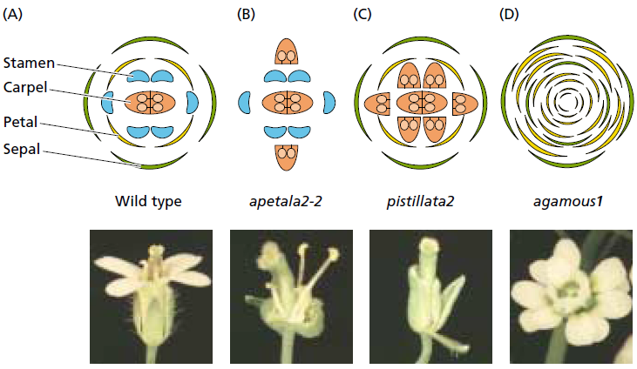

Slide 14
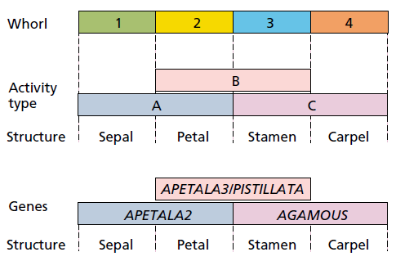
The ABC model

Slide 15
In 1991 the ABC model was proposed to explain how homeotic genes control organ identity.
Activity of type A alone specifies sepals.
Activities of both A and B are required for the formation of petals.
Activities of B and C form stamens.
Activity of C alone specifies carpels.

Slide 16
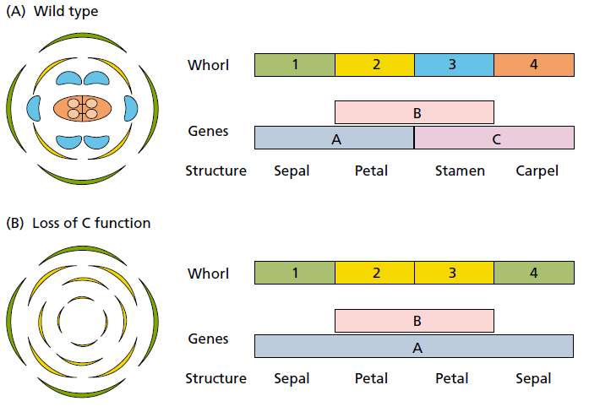

Slide 17
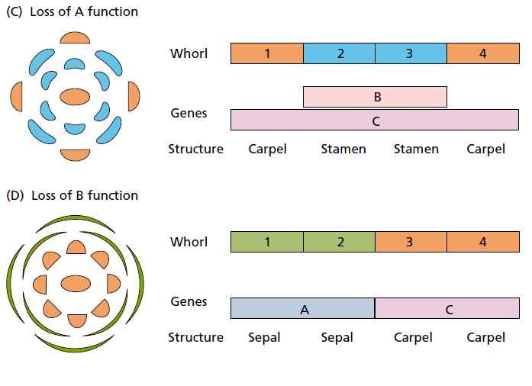

Slide 18
FLORAL EVOCATION: INTERNAL AND EXTERNAL CUES
May flower within a few weeks or may not for a few years.
Different species flower at widely different ages – internal factor – autonomous regulation.
Some plants exhibit an absolute requirement for the proper environmental cues – obligate or qualitative response.
Absolute requirement for the proper environmental cues but occur in absence also – facultative or quantitative response.

Slide 19
Photoperiodism and vernalization - two of the most important mechanisms.
PHOTOPERIODISM - response to the length of day.
VERNALIZATION – promotion of flowering at high temperature – by exposing plant to low temperature.
The evolution of both internal and external control systems enables plants to carefully regulate flowering at the optimal time for reproductive success.

Slide 20
PHASE CHANGE
During postembryonic development, the shoot apical meristem passes through three developmental stages in sequence:
The juvenile phase
The adult vegetative phase
The adult reproductive phase
The transition from one phase to another is called phase change.

Slide 21
Transition from juvenile to adult involve changes in vegetative characteristics, such as
leaf morphology,
phyllotaxy,
thorniness,
rooting capacity, and
leaf retention in deciduous plants.

Slide 22
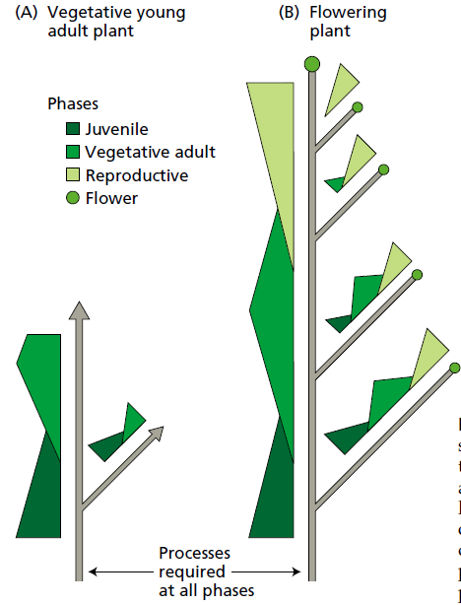

Slide 23
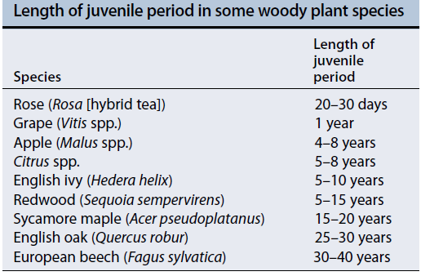

Slide 24
Size of the plant rather than age is more important in terms of phase change.
Once adult phase has been attained it persists.
Phase change can also be influenced by nutrients, gibberellins and other chemicals (such as carbohydrates).
Other important features that produce flowering in green plants are competence and determination.

Slide 25
A bud is said to be competent if it is able to flower when given the appropriate developmental signal.
A bud is said to be determined if it progresses to the next developmental stage (flowering) even after being removed from its normal context.

Slide 26
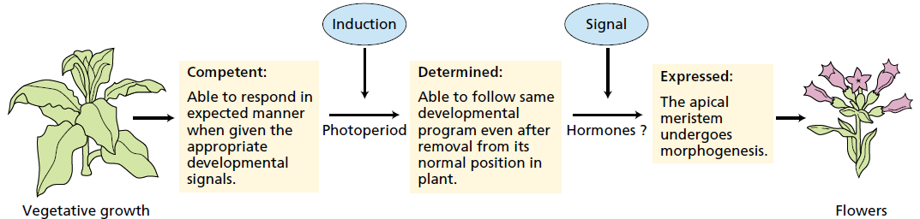

Slide 27
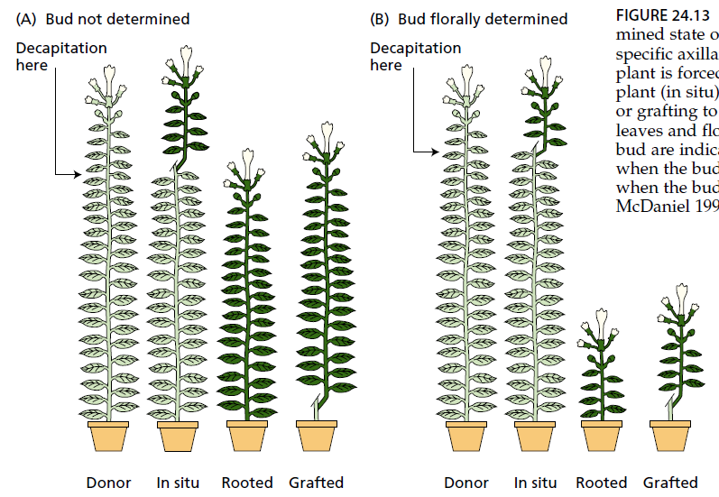

Slide 28
PHOTOPERIODISM: MONITORING DAY LENGTH
Allows for a seasonal response.
Found in both animals and plants.
A number of responses are influenced by day length in plants, including
    The initiation of flowering,
    Asexual reproduction,
    The formation of storage organs, and
    The onset of dormancy.

Slide 29
The phenomenon was demonstrated by Garner and Allard (1920s) and they divided the plants into following broad categories:
Short-day plants (SDPs) flower only in short days (qualitative SDPs), or their flowering is accelerated by short days (quantitative SDPs).
Long-day plants (LDPs) flower only in long days (qualitative LDPs), or their flowering is accelerated by long days (quantitative LDPs).

Slide 30
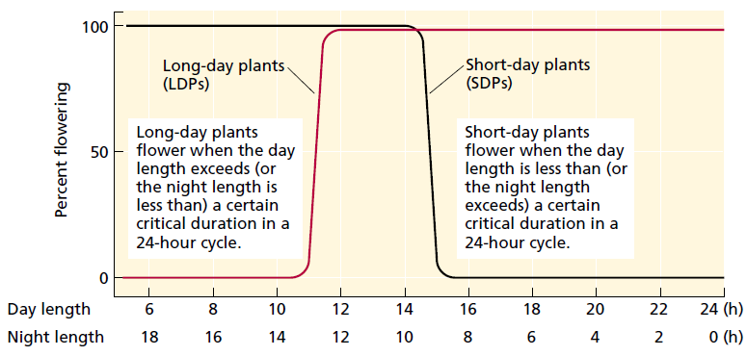

Slide 31
Some plants sense dual day length
Long-short-day plants (LSDPs) flower only after a sequence of long days followed by short days. Egs: Bryophyllum, Kalanchoe, and Cestrum nocturnum
2. Short-long-day plants (SLDPs) flower only after a sequence of short days followed by long days. Egs: Trifolium repens (white clover), Campanula medium (Canterbury bells), and Echeveria harmsii (echeveria)

Slide 32
Species that flower under any photoperiodic condition are referred to as day-neutral plants.
Day-neutral plants (DNPs) are insensitive to day length.
Flowering in DNPs is typically under autonomous regulation—that is, internal developmental control.
Egs: Phaseolus vulgaris (kidney bean), Castilleja chromosa (desert paintbrush) and Abronia villosa (desert sand verbena)

Slide 33
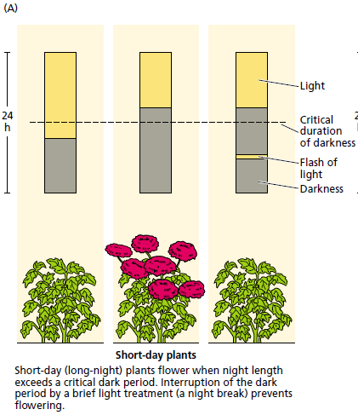

Slide 34
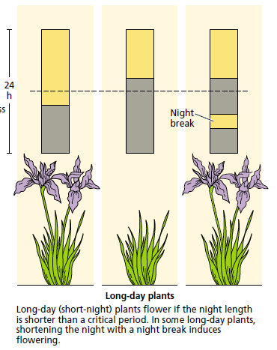

Slide 35
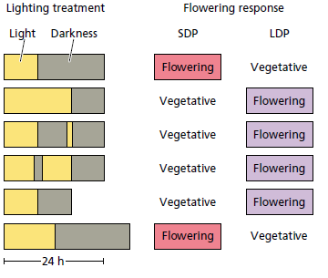

Slide 36
Plants can perceive either night or day length.
A small break in dark period can inhibit flowering in SDPs.
Leaf is the site that senses photoperiod – photoperiodic induction.
Photoperiodic stimulus can be transferred.
Floral stimulus is transferred by the phloem.
Phytochrome regulates photoperiodic response.

Slide 37
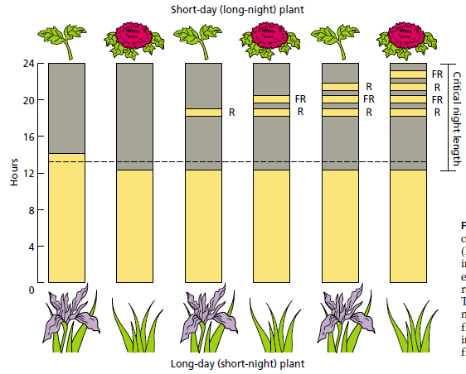

Slide 38
VERNALIZATION: PROMOTING FLOWERING BY COLD
Vernalization is the process whereby flowering is promoted by a cold treatment given to a fully hydrated seed or to a growing plant.
Plants differ considerably in the age at which they become sensitive to vernalization.
The effective temperature range for vernalization is from just below freezing to about 10°C.

Slide 39
The response usually requires several weeks of exposure to low temperature, but the precise duration varies widely with species and variety.
Vernalization can be lost as a result of exposure to devernalizing conditions, such as high temperature.
Vernalization appears to take place primarily in the shoot apical meristem.
In developmental terms, vernalization results in the acquisition of competence of the meristem to undergo the floral transition.

